Slide 1
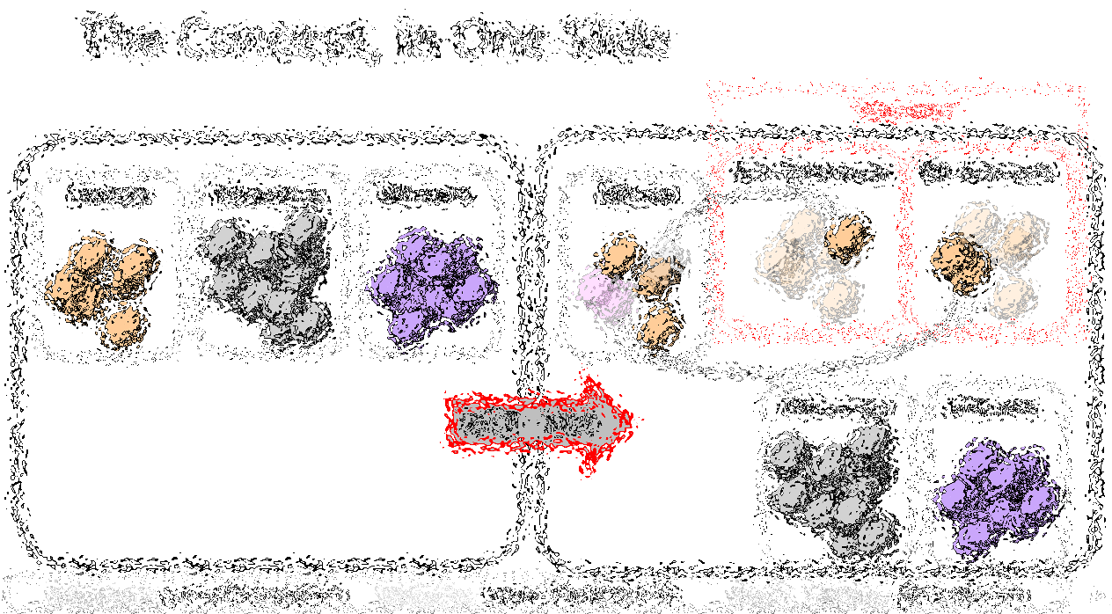
Bip300: Getting to 100% Bitcoin Dominance (and Beyond)
Paul Sztorc
Bitcoin2021 – June 4th

Slide 2

The Concept, in One Slide
“Sidechains”
n
n
Bit-Ethereum
Bit-Monero
Bitcoin
Ethereum
Monero
Bitcoin
Bip300
Bip300
BIP 300
Ethereum
Monero

Slide 3

The Goal
Smart Contracts DeFi Turing Completeness Ring Signatures zk-Snarks Large Blocksizes
NFTs Oracles
Mimblewimble
…(etc)
Bitcoin does seem great… but can it do _______ ?
Actually we DON’T want Bitcoin to do ______ in the first place because it is actually a bad due to _______, as you can read ______. But if by ______ you really mean ______, then yes Bitcoin can do that! Eventually we are working on _____ which should be able to do ______ even better than ______ anyway but it is actually a good thing that the protocol is so difficult to upgrade beca …
Yes. See BIP 300.
Noob
Bitcoiner
Notes:
Two people conversing, speech bubbles
“But can Bitcoin do _____?”
“Yes, see Bip300”

Slide 4
Fringe Ideas
I can improve Bitcoin! It only needs my new idea: _______ !! When can you merge my code ??
You can’t just merge something into Bitcoin -- It affects everyone else’s nodes!! Besides, ______ has been proposed before and you need to read ______ so that you can learn why everyone hates it, especially our infallible _______ who would have done it by now if it were a good idea. ________ is a SCAM and you are trying to ATTACK BITCOIN!! Even if your idea was good it would probably take years to get consensus and get merged into …
Noob (and/or Fringe Genius)
Use BIP 300.
Good luck!!
Bitcoiner
Notes:
Picture of a stick figure with a top hat, with a thought bubble, thinking about: Blocksize, TC, KYC

Slide 5
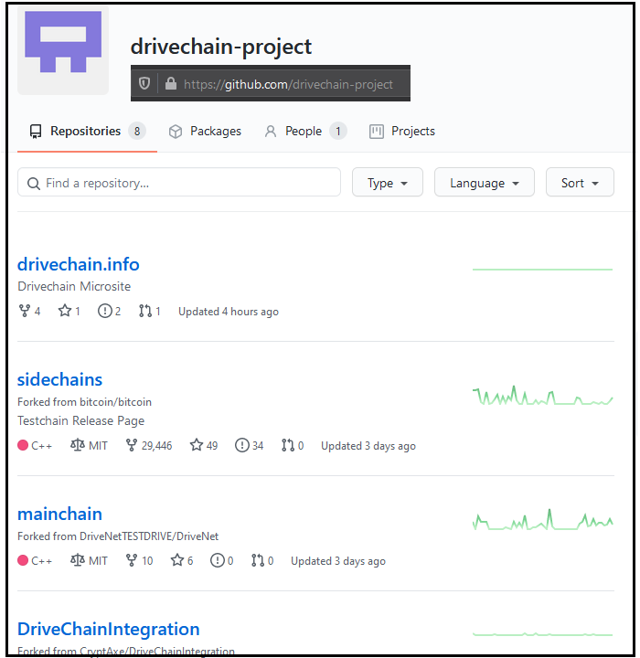
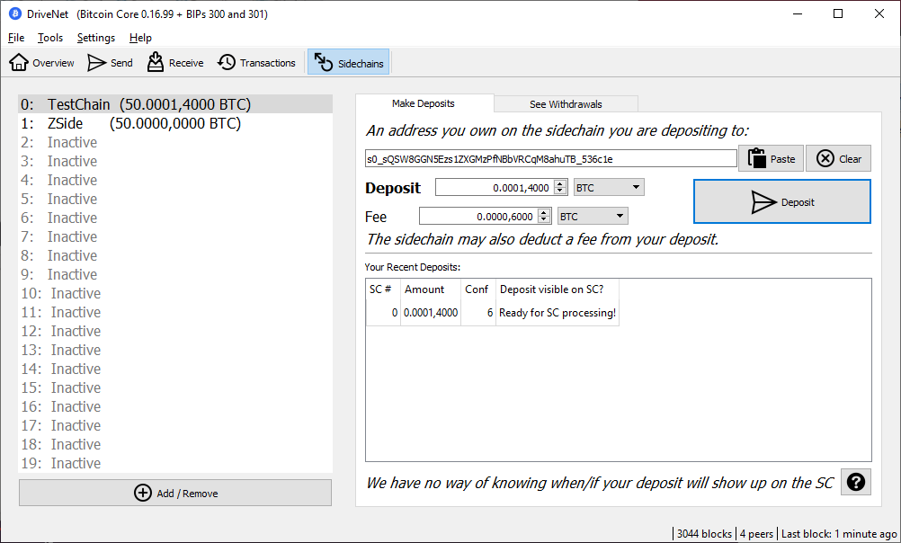
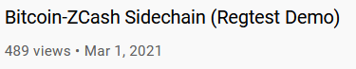
Three Aspects
Not Vaporware
Full Autonomy
Protect Base Layer
Improve Miner Incentives
Notes:
Also, has screenshots of Github/Gui/Youtube zcash Video

Slide 6
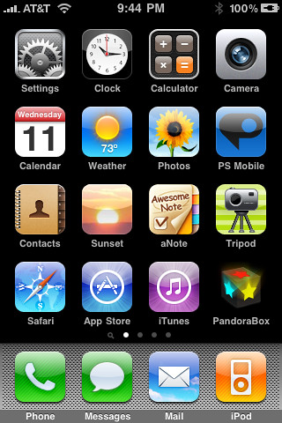
(#1) Full Autonomy
Bip300 Sidechains
zCash (Altcoin)
Bit-zCash
Bit-Monero
Lightning Apps
Strike
Zap
Metaphor
Bitcoin Core
Notes:
Should look like a screenshot from an iPhone, with lots of little apps called “zCash” “eth” “bch”, “…” but with a Big “Bip300” frame around it. Outside of the Bitcoin Frame is a Bitcoin Core app, and a “Lightning Frame” with LN Apps, and a word processor, web browser, calculator, etc
Have some ghosted-out coins, that move from Bitcoin Core app to the LN
At the bottom is a bullet point called “Cool Asymmetry”

Slide 7
(#1) Full Autonomy
Bip300 Sidechains
zCash (Altcoin)
Bit-zCash
Bit-Monero
Lightning Apps
Strike
Zap
Metaphor
Bitcoin Core
Notes:
Should look like a screenshot from an iPhone, with lots of little apps called “zCash” “eth” “bch”, “…” but with a Big “Bip300” frame around it. Outside of the Bitcoin Frame is a Bitcoin Core app, and a “Lightning Frame” with LN Apps, and a word processor, web browser, calculator, etc
Have some ghosted-out coins, that move from Bitcoin Core app to the LN
At the bottom is a bullet point called “Cool Asymmetry”

Slide 8
(#1) Full Autonomy
Bip300 Sidechains
zCash (Altcoin)
Bit-zCash
Bit-Monero
Lightning Apps
Strike
Zap
Metaphor
Bitcoin Core
Notes:
Should look like a screenshot from an iPhone, with lots of little apps called “zCash” “eth” “bch”, “…” but with a Big “Bip300” frame around it. Outside of the Bitcoin Frame is a Bitcoin Core app, and a “Lightning Frame” with LN Apps, and a word processor, web browser, calculator, etc
Have some ghosted-out coins, that move from Bitcoin Core app to the LN
At the bottom is a bullet point called “Cool Asymmetry”

Slide 9
(#2) Base Layer is Safe
= Block Header
= List of transactions
December 2020
January 2021
February 2021
March 2021
April 2021
Layer 2 (Bit-Monero)
Layer 1 (Bitcoin Core)
Notes:
Two blockchains, (main and side), The sidechain has 3 month epochs with are defined by one hash.
There is an arrow from the hash to the layer1 coinbase txn, denoting the insertion

Slide 10
(#2) Base Layer is Safe
= Block Header
= List of transactions
December 2020
January 2021
February 2021
March 2021
April 2021
Layer 2 (Bit-Monero)
3 Months = One 32-byte Hash
3 Months = One 32-byte Hash
e320b6c2fffc8d750423db8b1eb942ae710e951ed797f7affc8892b0f1fc122b
81cd02ab7e569e8bcd9317e2fe99f2de44d49ab2b8851ba4a308000000000000
Layer 1 (Bitcoin Core)
Inserted into Layer1 coinbase txn
Notes:
Two blockchains, (main and side), The sidechain has 3 month epochs with are defined by one hash.
There is an arrow from the hash to the layer1 coinbase txn, denoting the insertion

Slide 11
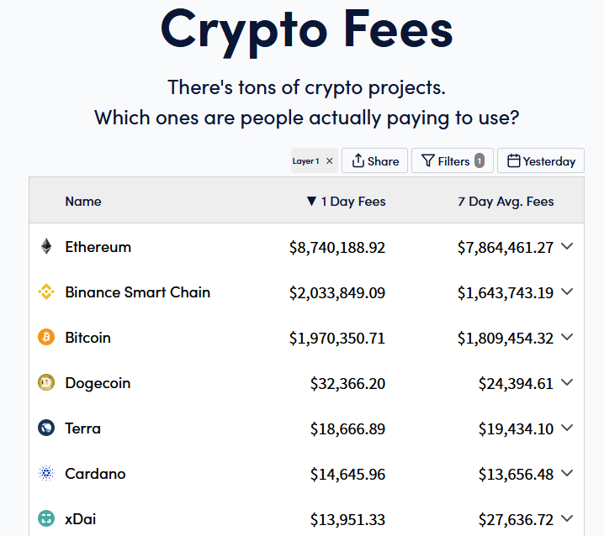
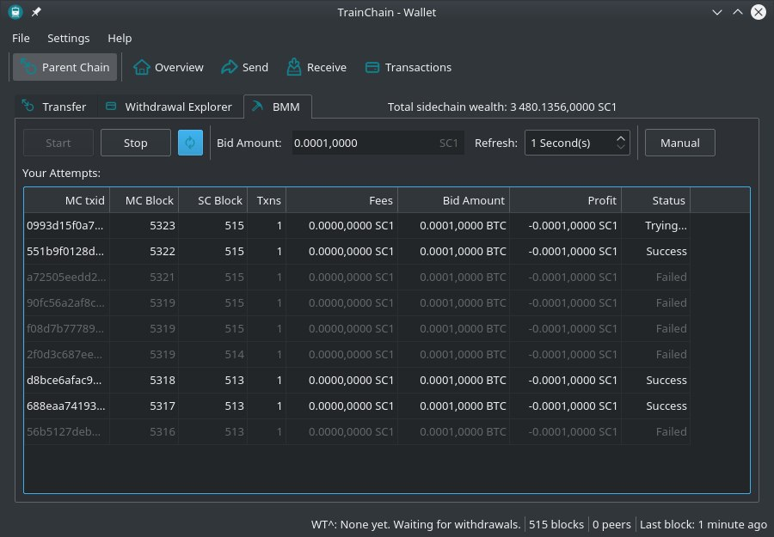
(#3) Improve Mining Incentives (Bip 301)
Get all of the fees, on all of the chains!
Miners can ignore Sidechain / Altcoin software.
Taken from https://cryptofees.info/ this morning.
Notes:
No temptation to run Altcoin Nodes
Miners collet fees from every txn, on every blockchain!
Miners don’t need to upgrade their software anymore.

Slide 12

What do we use BIP 300 for…?
(In other words: Which altcoins are worth copying?)
Art: “When I paint my masterpiece” – Nick Kenrick (?) - Creative commons license

Slide 13
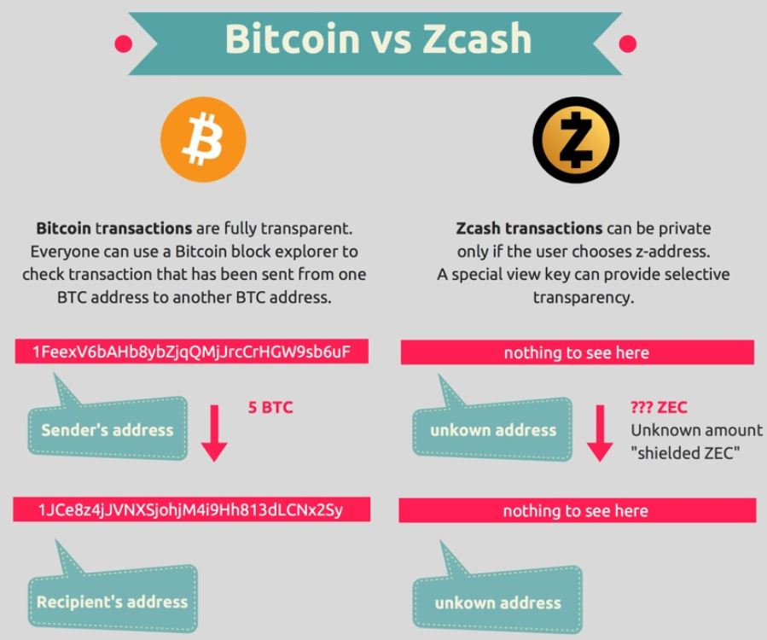
Altcoins we should copy (?): zCash
Image from blockchainhub.net : https://blockchainhub.net/blog/infographics/zcash-explained/

Slide 14
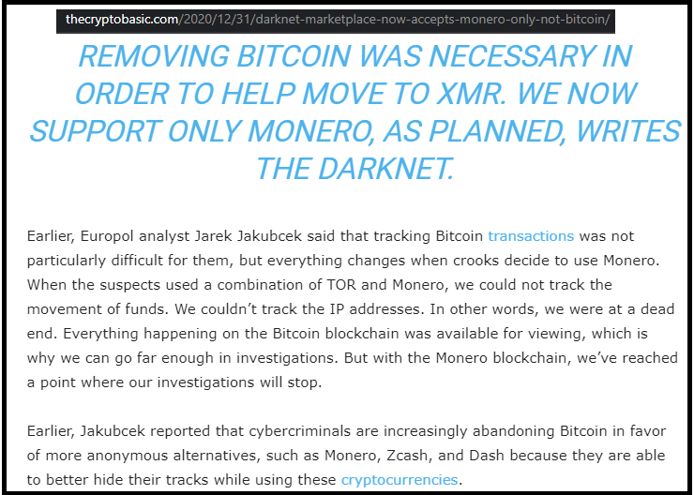
Losing Customers to Monero (?)
Lame!

Slide 15
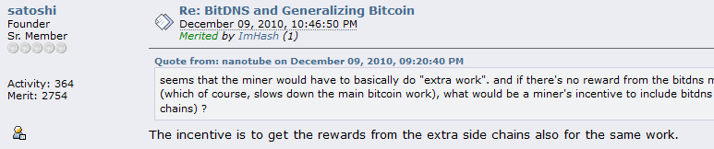
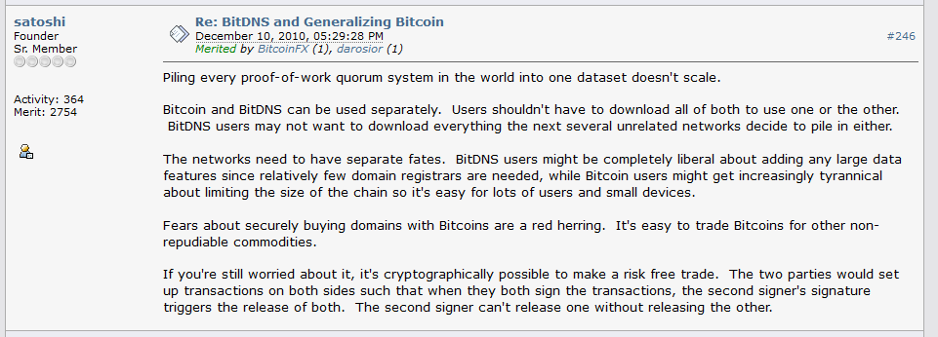
Altcoins we should copy (?): NameCoin
Fun facts -- in this thread, Satoshi: * Invents what is now known as Merged Mining. * Assumes that there will be many different blockchains that pay different fees (as if this were non-controversial!).
* The term “side chain” is used numerous times!

Slide 16
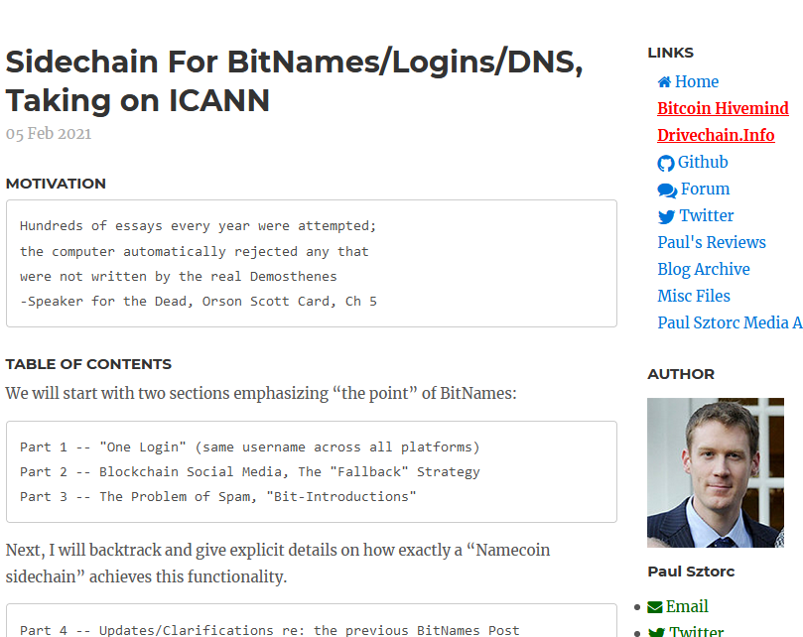
Altcoins we should copy (?): NameCoin
Screenshot #0 from www.truthcoin.info/blog/bitnames/

Slide 17
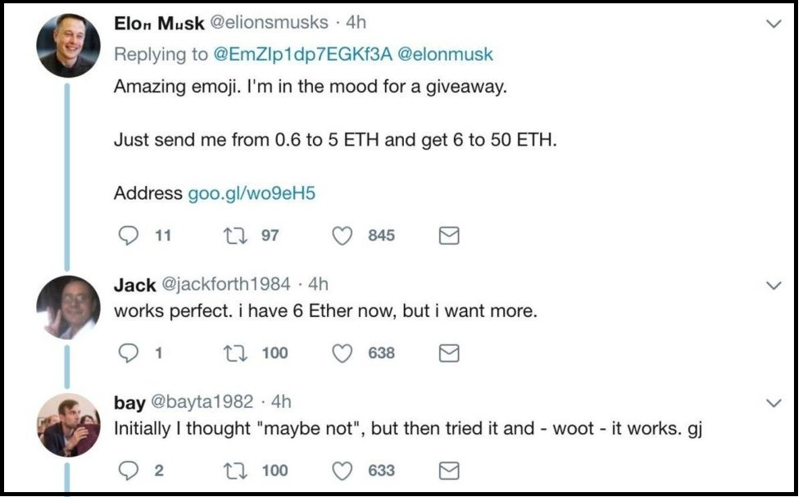
Screenshot #1 from www.truthcoin.info/blog/bitnames/
Altcoins we should copy (?): NameCoin

Slide 18
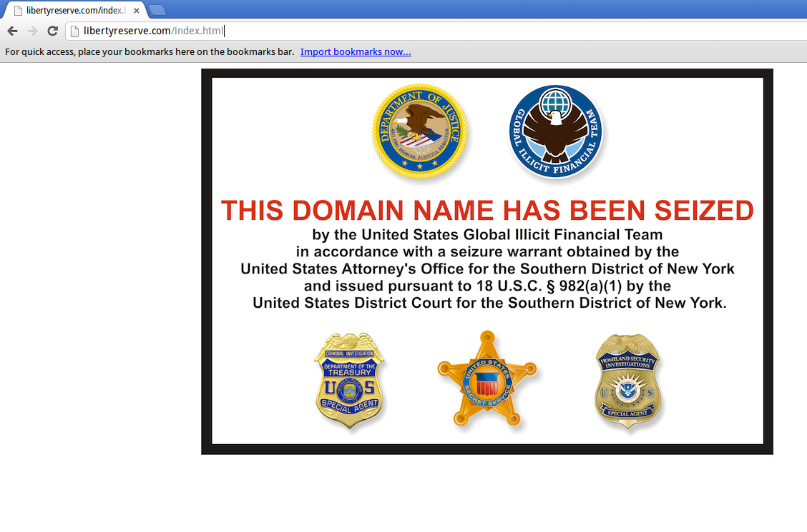
Screenshot #2 from www.truthcoin.info/blog/bitnames/
Altcoins we should copy (?): NameCoin

Slide 19
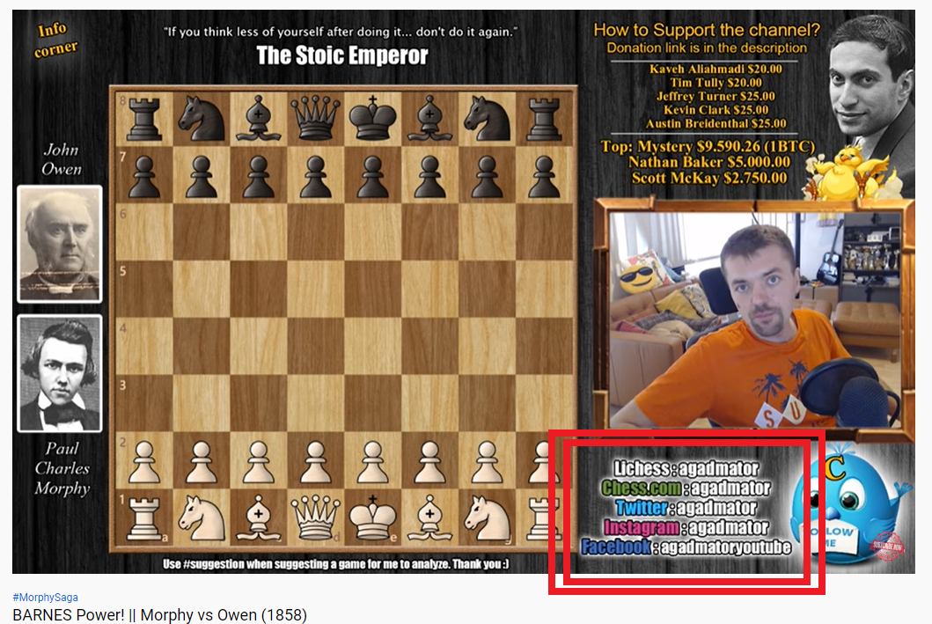
Screenshot #3 from www.truthcoin.info/blog/bitnames/
Altcoins we should copy (?): NameCoin

Slide 20
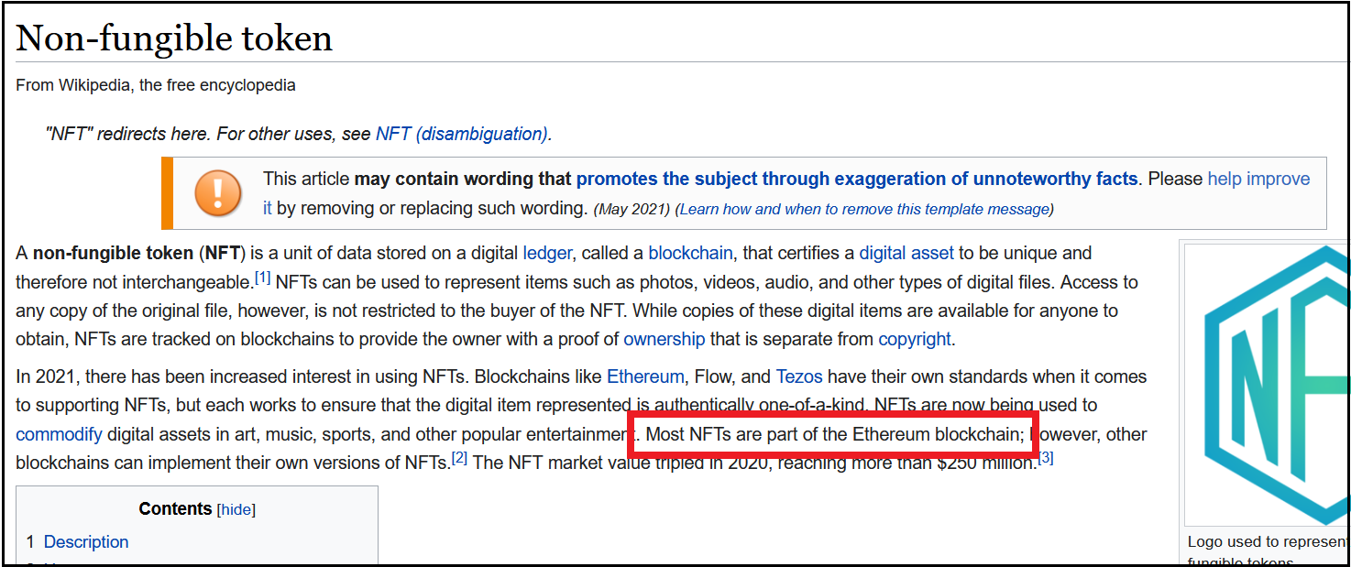
Altcoins we should copy (?): XCP / BitAssets / ERC20
Screenshots NFT craze, Cap table, Outstanding Bonds
So lame!!

Slide 21

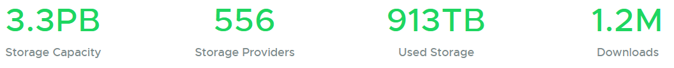
Altcoins we should copy (?): Sia
P2P Cloud Storage – Managed via Blockchain
Running for 5 years
No files ever lost?
$1-2 per TB/month (vs $23 on Amazon S3)
https://sia.tech

Slide 22
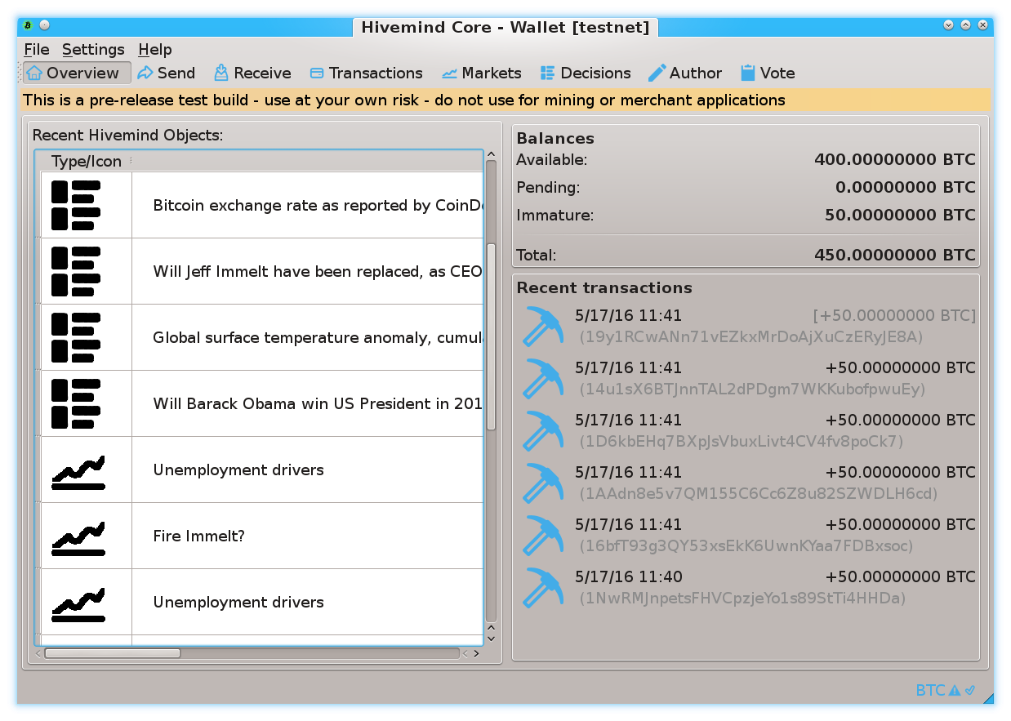
Prediction Markets
Screenshots from my own BTC sidechain project
www.BitcoinHivemind.com

Slide 23
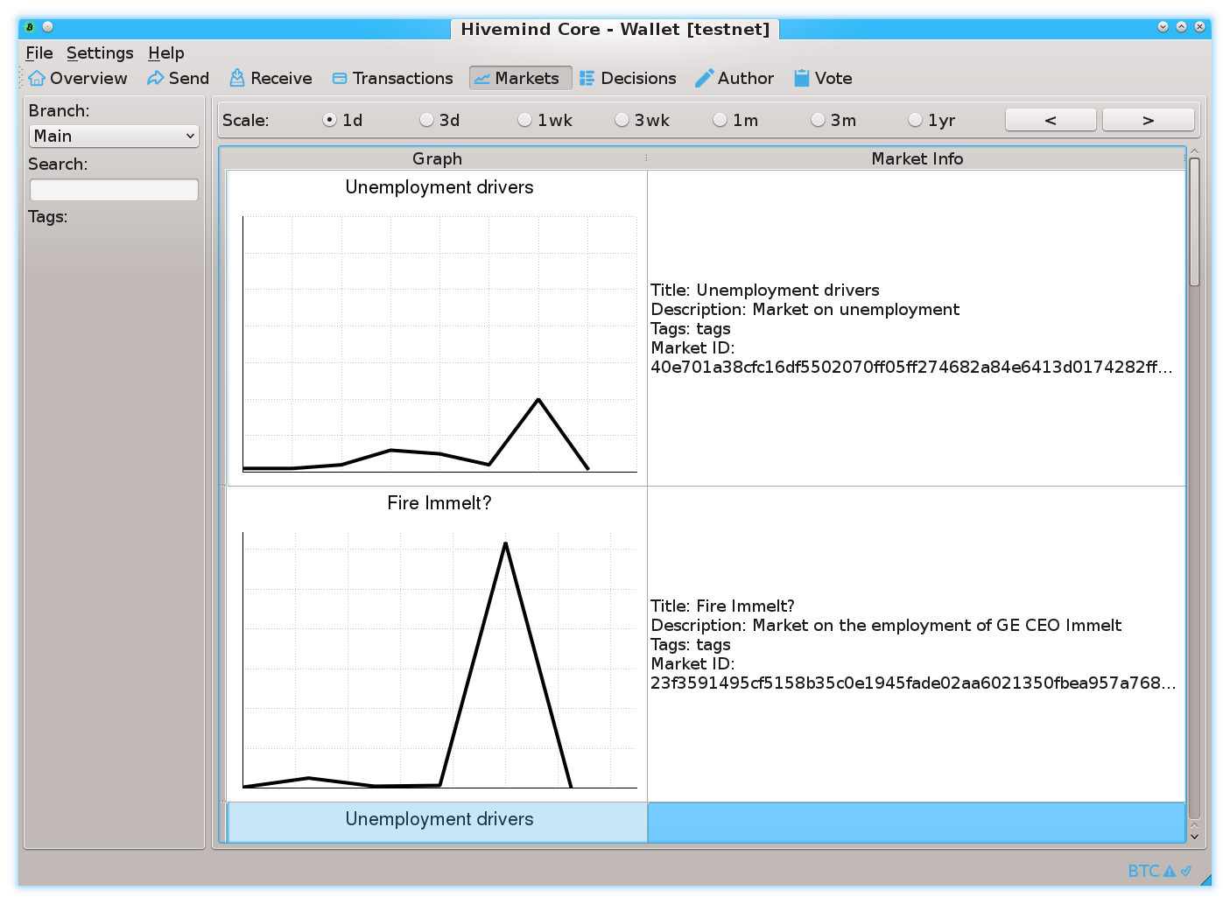
Prediction Markets
Screenshots from my own BTC sidechain project
www.BitcoinHivemind.com

Slide 24
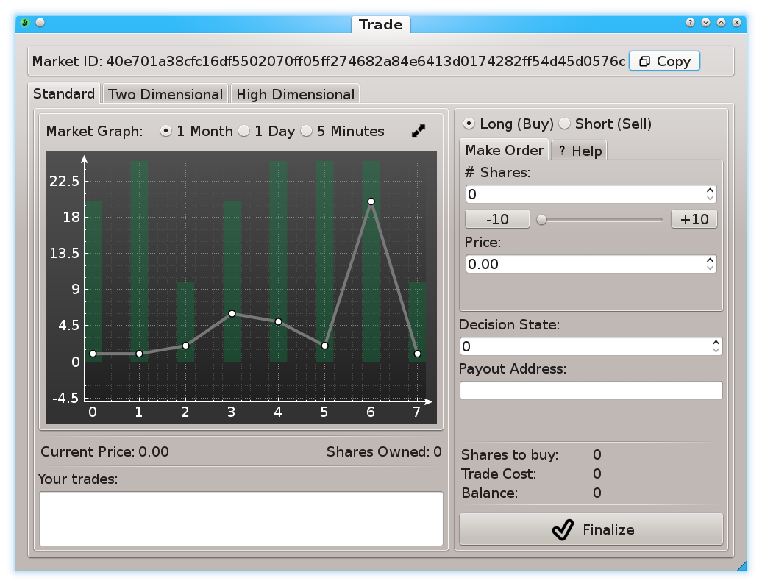
Prediction Markets
Screenshots from my own BTC sidechain project
www.BitcoinHivemind.com

Slide 25
Prediction Markets
Screenshots from my own BTC sidechain project
www.BitcoinHivemind.com
Key Idea: “Futarchy” -- futures markets for how well certain leaders would perform, if they were in charge.

Slide 26
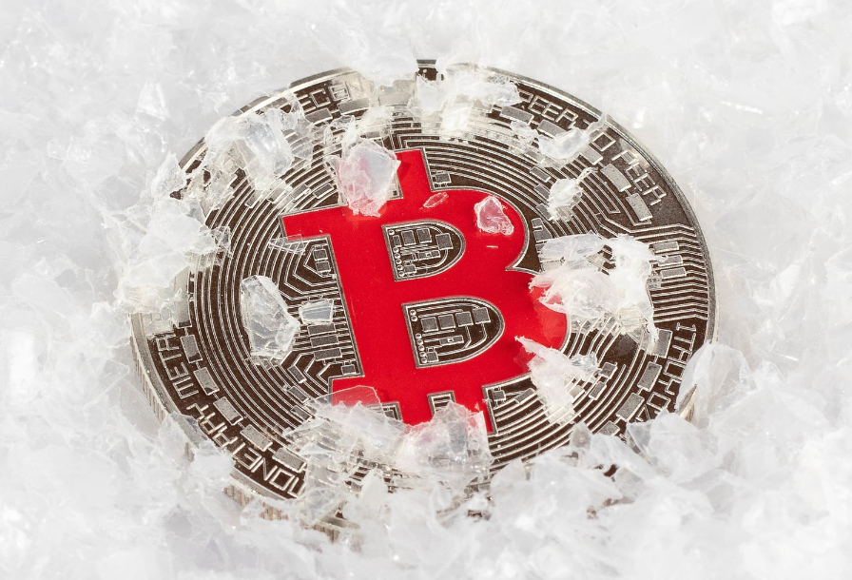
Finally: How Bip300 Improves Layer1
Never Change Layer 1 Again – “Protocol Ossification”
No “drama”.
No “mob rule”.
Shrink Layer1 Blocksize.
Improves Decentralization.
Protects your node.
“Frozen Bitcoin” - Marco Verch , Creative Commons License

Slide 27
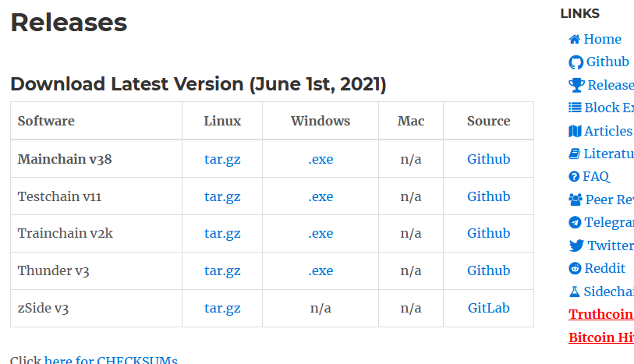
How to Get Bip300 Faster
drivechain.info/releases/
Drivechain = Bip 300+301
Learn !
Download the latest version
Talk
Soft forks need consensus
Invite on podcasts/whatever
View Altcoins Differently

Slide 28
Thank You for Your Attention! (Find me and talk to me!)

